Slide 1


Never Have a Bad Meal
ZOMATO RESTAURANTS ANALYSIS
RHEA CHAWLA

Slide 2

UNVEILING INSIGHTS -
ZOMATO RESTAURANTS ANALYSIS
Zomato, the popular online food delivery and restaurant discovery platform, has revolutionized the way people explore and experience cuisines from around the world. For food enthusiasts and budget-conscious diners, Zomato's vast dataset provides a treasure trove of information about restaurants' offerings, costs, and ratings. In this data analysis project, we aim to harness the power of data to predict two critical aspects of dining: the average cost for two people and the price range of restaurants.

Slide 3
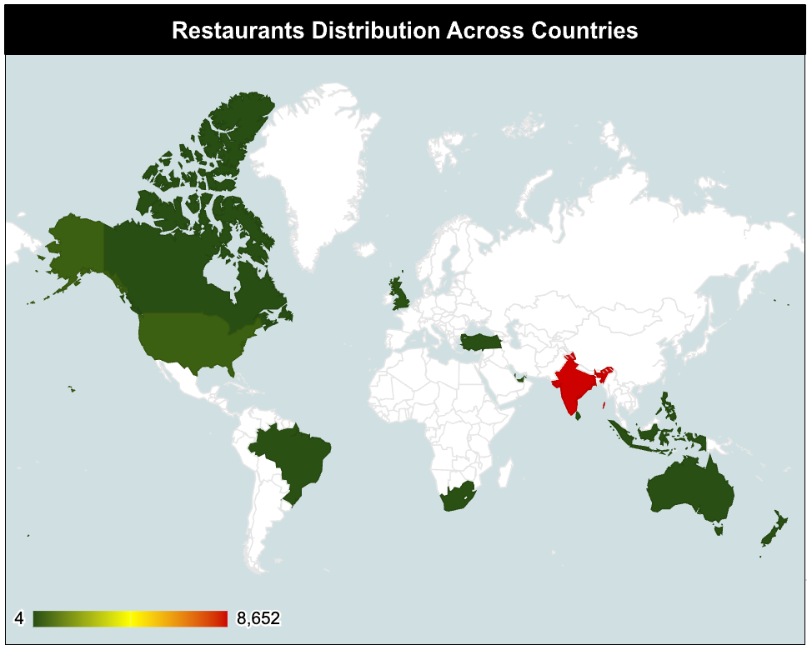
CHARTING OUR TERRITORIES: RESTAURANTS' GLOBAL FOOTPRINT
CONQUER WORLD WITH BEST FOOD

Slide 4
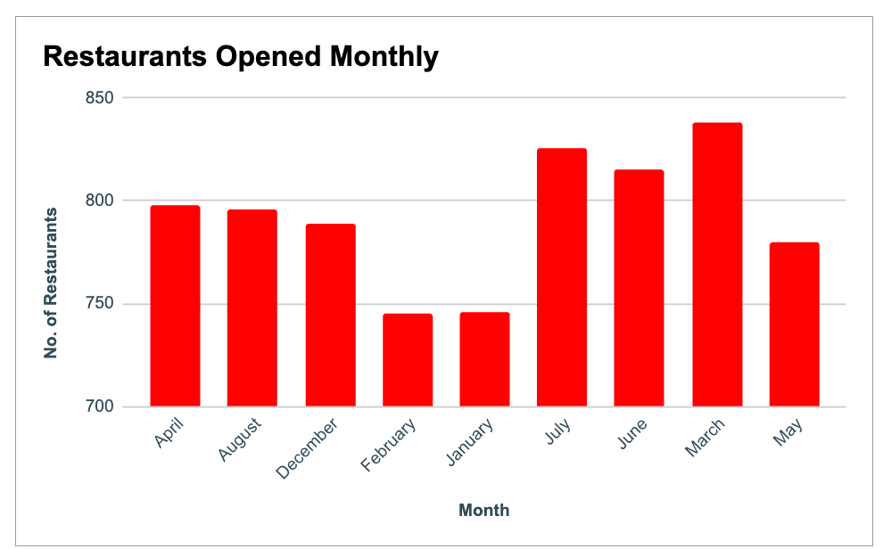
A JOURNEY THROUGH TIME
RESTAURANTS OVER THE YEARS
Embark upon a temporal odyssey! Witness the evolution of our culinary realm as we chart the number of restaurants that have sprouted forth with each passing year. This timeline illuminates our growth, highlighting the years that marked our expansion and fortitude.

Slide 5
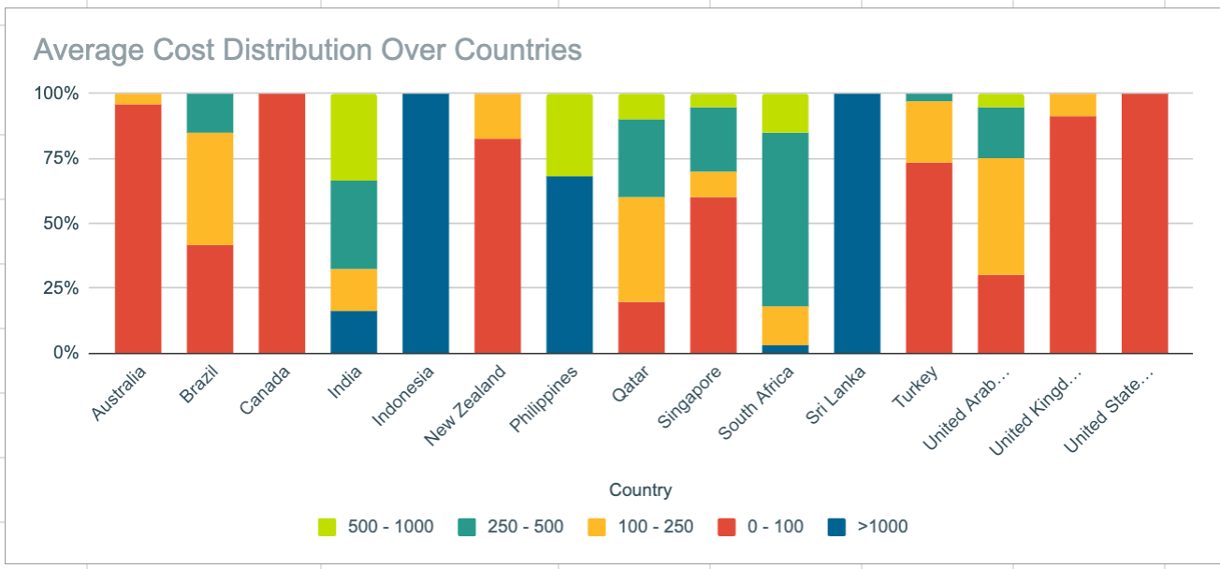
DELVING DEEPER
INDIA'S ELITE - PRICE RANGE 5
Venturing into India, we discover a treasure trove of elite establishments. Within the land of diversity and spice, we identify the total count of fine dining havens adorned with a price range of 4. These beacons of luxury beckon the discerning palates of connoisseurs.

Slide 6
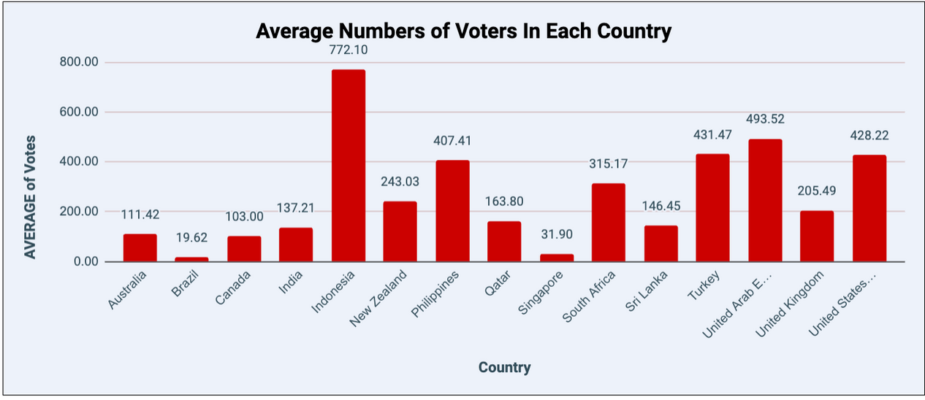
THE VOICE OF THE MASSES
AVERAGE VOTERS PER COUNTRY
Listen closely to the whispers of the crowd! Across each country, we hear the average voice, the number of voters who express their sentiments towards our restaurants. This symphony of opinions guides our understanding of customer engagement in different lands.

Slide 7
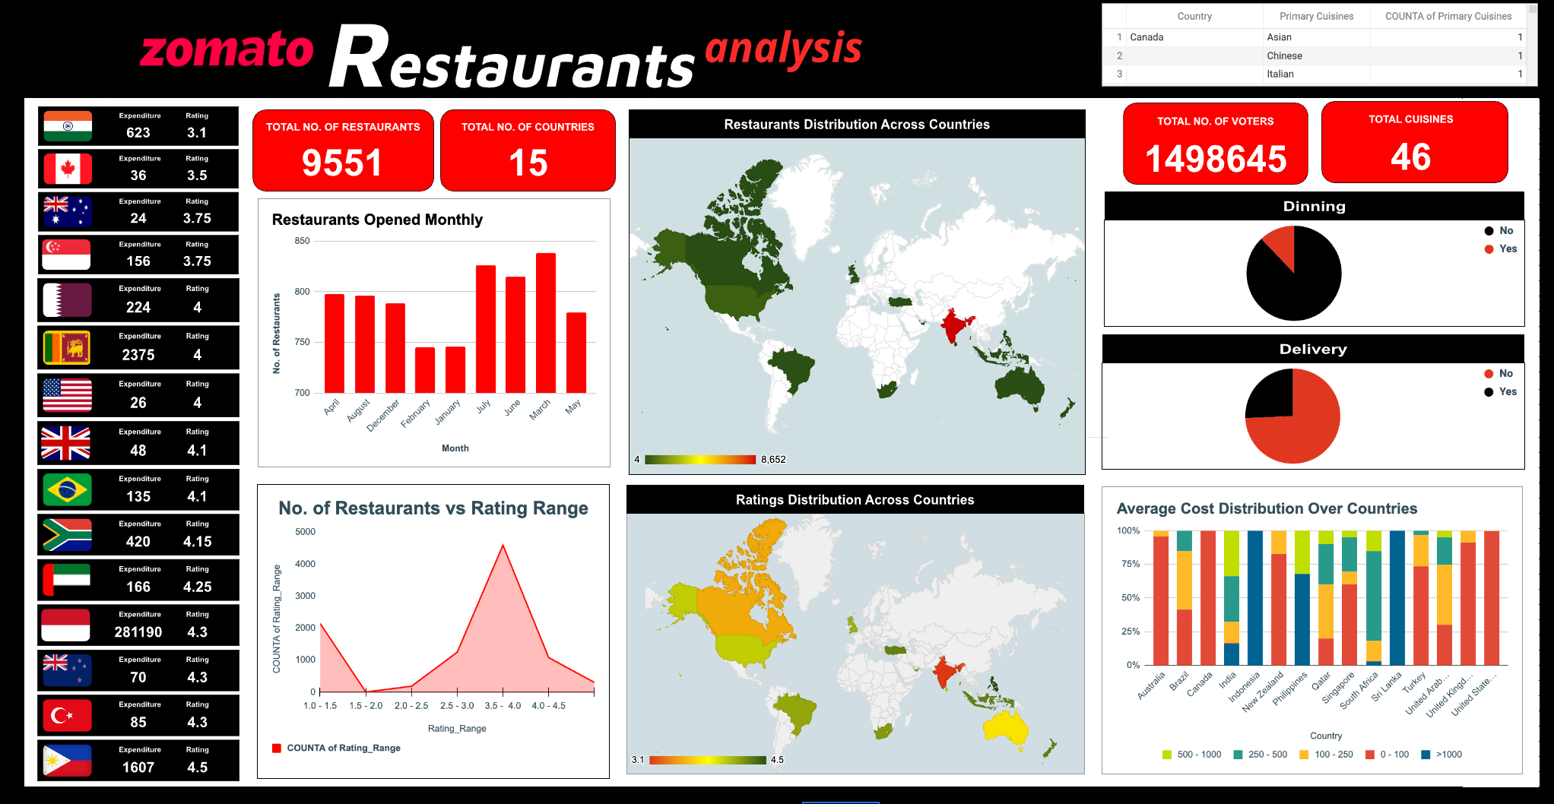

Slide 8

THANK YOU
NEVER HAD A BAD MEAL

